Slide 1

NATIONAL UNIVERSITY OF MODERN LANGUAGES
Faculty of Engineering and Computing
Department of Software Engineering

Slide 2

SOFTWARE DESIGN AND ARCHITECTURE
LECTURE NO. 09
Introduction to Software Engineering Design
Course Instructor: | Mr. Ahsan Arif
 | Lecturer Department of Software Engineering NUML Islamabad
Date: May 06, 2024
Software Engineering Design: Theory and Practice

Slide 3
LECTURE CONTENTS
  Component Diagram
    Introduction
      Component Rationale
    Elements of Component Diagram
    Construct Deployment Diagram for Case Study
Date: May 06, 2024
Software Engineering Design: Theory and Practice

Slide 4

UML – COMPONENT DIAGRAM (DEVELOPMENT VIEW)
Introduction:
A component is an encapsulated, reusable, and replaceable part of your software.
Rationale
Reducing and defying coupling between software components
Reusing existing components
Component diagrams are different in terms of nature and behavior.
Component diagrams are used to model the physical aspects of a system.
Now the question is, what are these physical aspects?
Physical aspects are the elements such as executables, libraries, files, documents, etc. which reside in a node.
Date: May 06, 2024
Software Engineering Design: Theory and Practice
Notes:
Class diagrams model the static behavior of objects, i.e.
Attributes of objects
Operation of objects
Relationships between objects.

Slide 5
Introduction (Cont.)
Component diagrams are used to visualize the organization and relationships among components in a system. These diagrams are also used to make executable systems.
The purpose of the component diagram can be summarized as:
Visualize the components of a system.
Construct executables by using forward and reverse engineering.
Describe the organization and relationships of the components.
Before drawing a component diagram, the following artifacts are to be identified clearly:
Files used in the system.
Libraries and other artifacts relevant to the application.
Date: May 06, 2024
Software Engineering Design: Theory and Practice
Notes:
Class diagrams model the static behavior of objects, i.e.
Attributes of objects
Operation of objects
Relationships between objects.

Slide 6
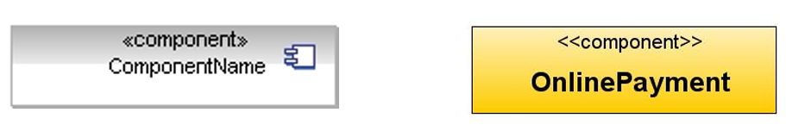
Elements of Component Diagram:
Component Notation
  A Component is a physical piece of a system, such as a compiled object file, piece of source code, shared library or Enterprise Java Bean (EJB).
Component Interfaces
  A provided interface of a component is an interface that the component realizes (What a component can do for others.)
  A required interface of a component is an interface that the component needs to function (What a component needs from others to work.)
Date: May 06, 2024
Software Engineering Design: Theory and Practice
Notes:
Provided Interface: What a component can do for others.
Required Interface: What a component needs from others to work.
These interfaces help ensure clear communication and collaboration between different parts of a software program. They promote modularity and make the code easier to understand and maintain.

Slide 7
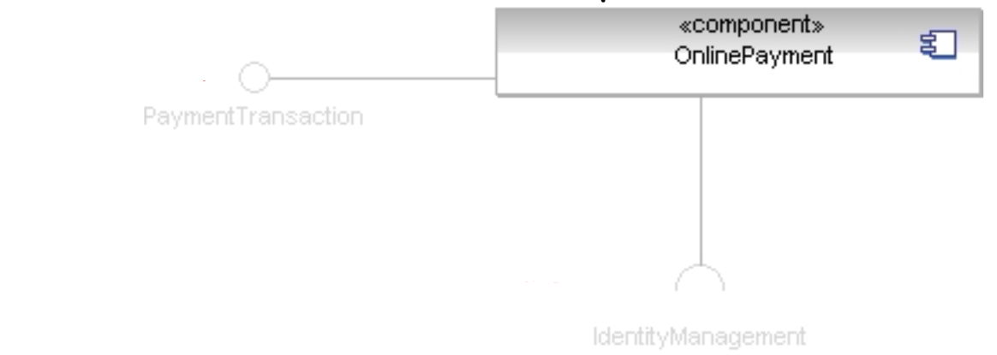
Elements of Component Diagram:
Provided interface
Required interface
Date: May 06, 2024
Software Engineering Design: Theory and Practice
Notes:
Class diagrams model the static behavior of objects, i.e.
Attributes of objects
Operation of objects
Relationships between objects.

Slide 8
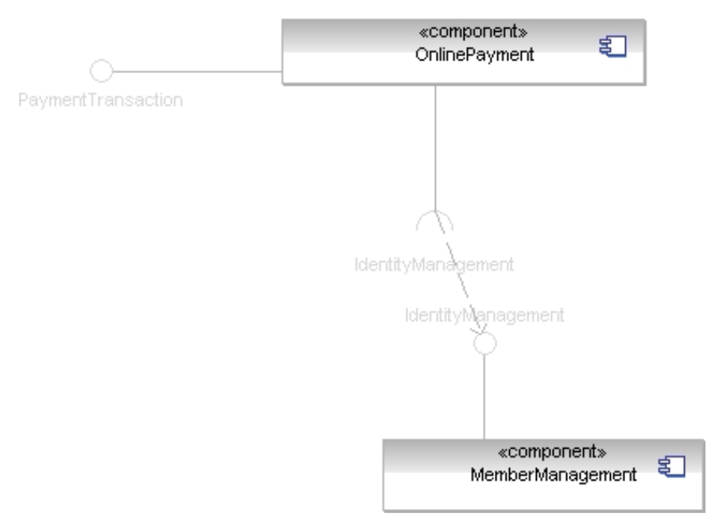
Elements of Component Diagram:
Component Assemblies
  Components can be “wired” together to form subsystems.
Date: May 06, 2024
Software Engineering Design: Theory and Practice
Notes:
Class diagrams model the static behavior of objects, i.e.
Attributes of objects
Operation of objects
Relationships between objects.

Slide 9
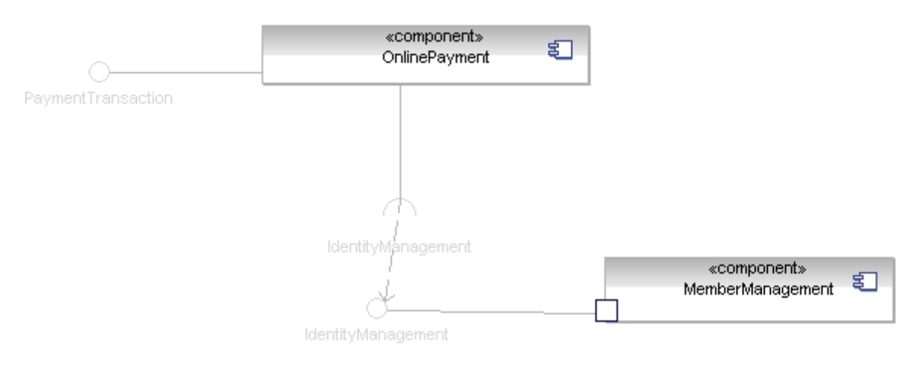
Elements of Component Diagram:
Ports
  A port indicates that the component itself does not provide the required interfaces (e.g., required or provided). Instead, the component delegates the interface(s) to an internal class.
Date: May 06, 2024
Software Engineering Design: Theory and Practice
Notes:
Class diagrams model the static behavior of objects, i.e.
Attributes of objects
Operation of objects
Relationships between objects.

Slide 10
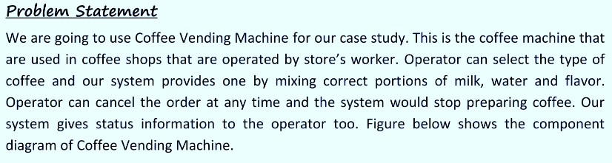
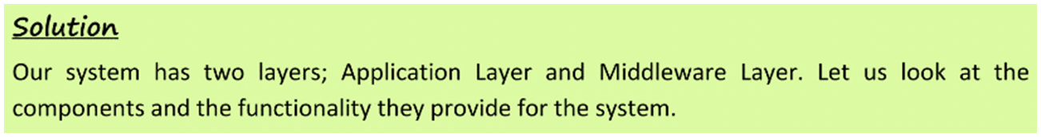
Constructing Component Diagram for Our Case Study
Date: May 06, 2024
Software Engineering Design: Theory and Practice
Notes:
Class diagrams model the static behavior of objects, i.e.
Attributes of objects
Operation of objects
Relationships between objects.

Slide 11
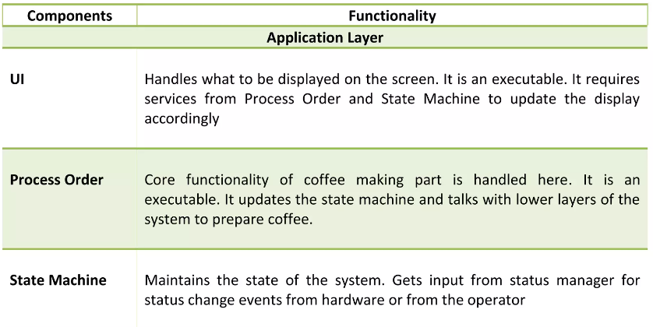
Constructing Component Diagram for Our Case Study
Date: May 06, 2024
Software Engineering Design: Theory and Practice
Notes:
Class diagrams model the static behavior of objects, i.e.
Attributes of objects
Operation of objects
Relationships between objects.

Slide 12
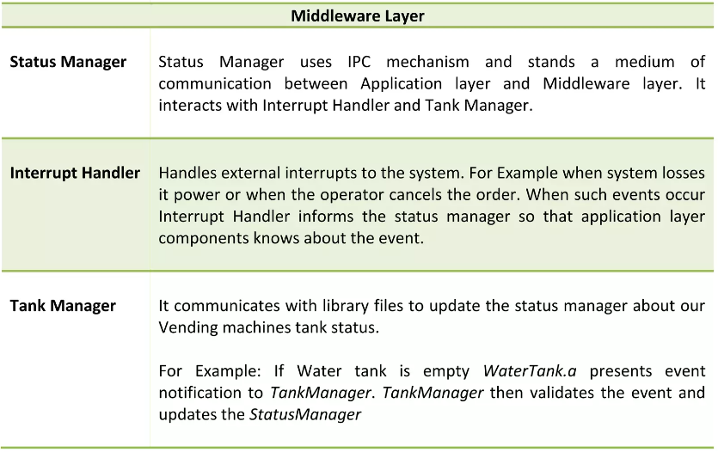
Constructing Component Diagram for Our Case Study
Date: May 06, 2024
Software Engineering Design: Theory and Practice
Notes:
Class diagrams model the static behavior of objects, i.e.
Attributes of objects
Operation of objects
Relationships between objects.

Slide 13
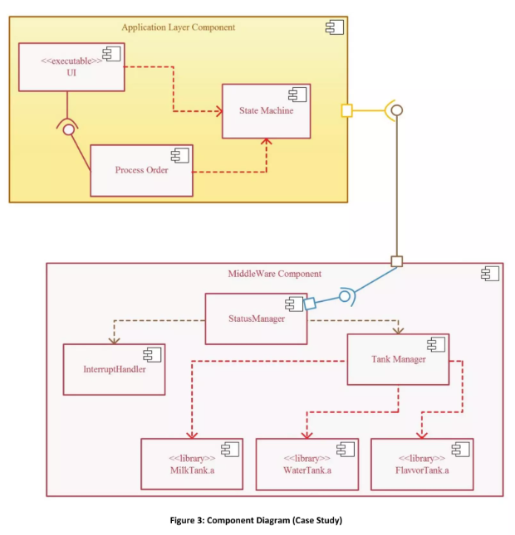
Constructing Deployment Diagram for Our Case Study
Date: May 06, 2024
Software Engineering Design: Theory and Practice
Notes:
Class diagrams model the static behavior of objects, i.e.
Attributes of objects
Operation of objects
Relationships between objects.

Slide 14
Summary
Component Diagram is used to represent physical implementation of a software design
Components can be grouped as Deployment Component, Work Product Component and Execution Component
Component states provide visual cue to the function of the component
Date: May 06, 2024
Software Engineering Design: Theory and Practice

Slide 15
Thank You...
Mr. Ahsan Arif
Lecturer (Dept. of Software Engineering)
ahsanarif.se42@gmail.com

